Slide 1

A Distortion-Resistant Routing Framework for Video Traffic in Wireless Multihop Networks
EAST WEST INSTITUTE OF TECHNOLOGY
Shri Malola Rangan K S | 1EW12IS093
Shrihari G H | 1EW12IS094
Yogendra Prasad Sangroula | 1EW12IS114
Vinyas B J | 1EW12IS109
Under the guidance of
Mrs.Usha M V
Asst.Prof
Department of ISE, EWIT
Presented By

Slide 2
Index
Introduction
Literature Survey
Existing System
Disadvantages of Existing System
Proposed System
Advantages of Proposed System
System Requirements
System Design
System Architecture
Modules
Pseudo Code for Path Discovery
References

Slide 3
Introduction
Traditional routing metrics designed for wireless networks are application- agnostic.
Reducing video distortion in a wireless network consisting of video traffic is critical in user perspective.
An analytical framework to understand and assess the impact of the wireless network on video transmission is constructed.
The frameworks are used to formulate a routing policy for minimizing video distortion.
Thus with simulations and testbed experiments we prove our protocol is efficient in reducing video distortion and minimizing the user experience degradation.

Slide 4
Literature Survey
Overview of the H.264/AVC video coding standard ^{[2]}
H.264/AVC is the newest video coding standard of the ITU-T Video Coding Experts Group.
The main goal is to enhance compression performance and a network-friendly video representation.
H.264/AVC has achieved a significant improvement in distortion-rate efficiency relative to existing standards.

Slide 5
Layered Coded vs. Multiple Description Coded video over error-prone networks^{[3]}
Layered Coding(LC) and Multiple Description Coding (MDC) have been proposed as source coding techniques that are robust to channel errors for video transmission.
LC and MDC have similar characteristics: they both generate multiple sub-bitstreams.
They are different in the sense that the sub-bitstreams for LC have different levels of importance while all sub-bitstreams for MDC are equally important.

Slide 6
Packet loss resilient transmission of MPEG video over the internet^{[4]}
A method is proposed to protect MPEG video quality from packet loss for real-time transmission over the Internet.
MPEG uses inter-frame coding to check the small packet loss rates in internet and to preserve quality of the received video.
Videos are sent over a single channel, using a packetization method that maximizes resistance to burst losses, while minimizing delay and overhead.

Slide 7
Existing System
Different Approaches are used to handle encoding and transmission such as,
Multiple Description Coding (MDC) .
Standards like the MPEG-4 and the H.264/AVC provide guidelines.
An analytical framework is developed to model the effects of wireless channel fading on video distortion.
The effects of packet-loss patterns and specifically the length of error bursts on the distortion of compressed video are examined.

Slide 8
Disadvantage of Existing System
The video quality is affected by:
The distortion due to compression at the source.
The distortion due to both wireless channel induced errors and interference.
The model is only valid for single-hop communication.

Slide 9
Proposed System
The user-perceived video quality can be significantly improved by accounting for application requirements.
A threshold is introduced with certain limit, if the packet losses exceed the threshold then the frames are discarded.
An analytical framework is developed to capture the impact of routing on video distortion.
Designing of practical routing protocol for distortion resilient video delivery.

Slide 10
Advantages of Proposed System
Minimize routing distortion.
Provides a dynamic programming approach that effectively captures the evolution of the frame-loss process.
We ensure that these frames are carried on the paths that experience the least congestion and the latter frames sent out on relatively more congested paths.
Our routing scheme is optimized for transferring video clips on wireless networks with minimum video distortion.

Slide 11
Software Requirements Hardware Requirements
System Requirements
Operating system : Windows 10
Coding Language : JAVA
IDE : Netbeans 8.0.1
System : Pentium IV 2.4 GHz
Hard Disk : 10 GB
Ram : 512 Mb

Slide 12
Data Flow Diagram
Avoid the Distortion in video transmission
Server
Client
Level 0
Level 1
Send request to server
Process request
Client
Chunk Video
Chunked packet

Slide 13
Level 2
Analyzing path
Checks for less Congestion
Chunked packet
Optimal path detected
Level 3
Transfer I frames into less Congestion path
Receive video
Server
Play video

Slide 14
Use Case
Diagram
Send Request for video
Process request
Chunk video
Analysis the path
Transfer packets
Server
Client
Receive packets
Play

Slide 15
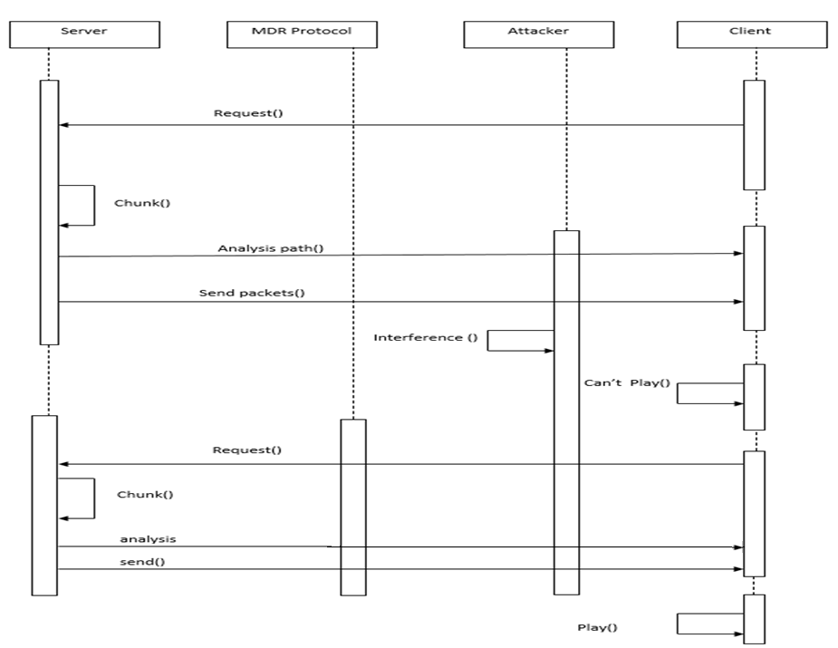
Sequence
Diagram

Slide 16
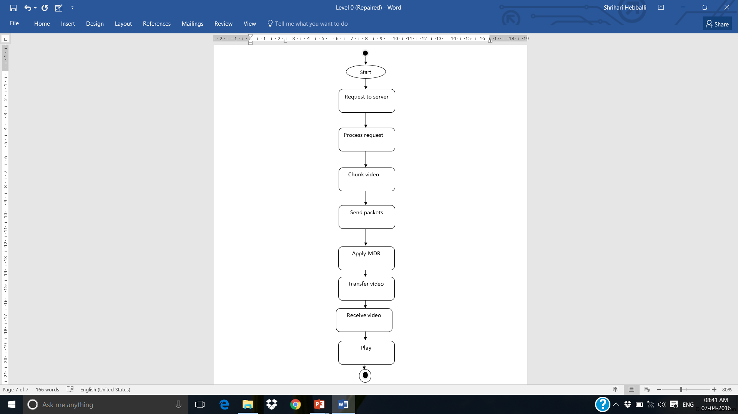
Activity
Diagram

Slide 17
System Architecture

Slide 18
Modules
PHY and MAC layer Modeling
The analytical model couples the functionality of the physical and MAC layers of the network with the application layer.
The model for the lower layers computes the packet-loss probability.

Slide 19
Video Distortion Model
The distortion is broken down into source distortion and wireless transmission distortion.
Assuming that the packet losses in different frames in the GOP are independent events, the transition probabilities for the process can be computed.

Slide 20
Pseudo Code for Path Discovery in MDR
Procedure: Path_Discovery
Input: Source node ‘S’, Destination node ‘D’
Output: Distortion Resistant Path.
Step 1: Begin
Step 2: Send Route request.
Step 3: For all nodes
If
request message is for particular node D
Send Route reply to source S
Else
forward request message to next nodes.
Add the nearest node to the path.
End if
End for
Step 4: return the path to source.
Step 5: End.

Slide 21
References
^{[1]} George Papageorgiou, Member, IEEE, ACM, Shailendra Singh, Srikanth V.Krishnamurthy, Fellow, IEEE, Ramesh Govindan, Fellow, IEEE, and Tom La Porta, Fellow, IEEE, “A Distortion-Resistant Routing Framework for Video Traffic in Wireless Multihop Networks”, IEEE/ACM TRANSACTIONS ON NETWORKING, VOL. 23, NO. 2, APRIL 2015.
^{[2]} T. Wiegand, G. J. Sullivan, G. Bjontegaard, and A. Luthra, “Overview of the H.264/AVC video coding standard”.
^{[3]} Y.-C. Lee, J. Kim, Y. Altunbasak, and R. M. Mersereau, “Layered coded vs. multiple description coded video over error-prone networks”.
^{[4]} J. M. Boyce, "Packet loss resilient transmission of MPEG video over the internet”

Slide 22
THANK YOU

